Slide 1
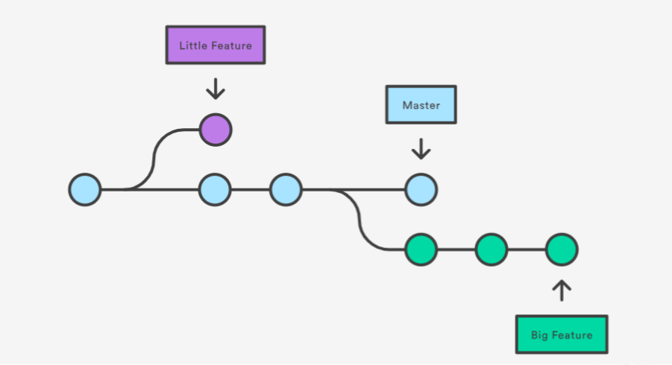
GIT Branching

Slide 2
COMMANDS:
COMMANDS | USAGE
git branch | List branches (the asterisk denotes the current branch)
git branch -a | List all branches (local and remote)
git branch [branch name] | Create a new branch
git branch -d [branch name] | Delete a branch
git push origin --delete [branch name] | Delete a remote branch
git checkout -b [branch name] | Create a new branch and switch to it
git checkout -b [branch name] origin/[branch name] | Clone a remote branch and switch to it
git branch -m [old branch name] [new branch name] | Rename a local branch
git checkout [branch name] | Switch to a branch

